Slide 1
Subject Name : Operating System Presentation Title: Multiprocessing Systems
JEPPIAAR INSTITUTE OF TECHNOLOGY
“Self-Belief | Self Discipline | Self Respect”
Department of Computer Science and Engineering
Team Members:
Students Name Reg.No:
1.Moreen Joice.J 210618104030
2.Prabha.k 210618104032
3.Abarna.E 210618104001
4.Saranya.I 210618104045
5.Vidula.V 210618104054
6.Swetha.P 210618104052

Slide 2
MULTIPROCESSOR SYSTEMS
Most computer systems are single processor systems i.e they only have one processor. However multiprocessor or parallel systems have multiple processors working in parallel that share the computer clock, memory, bus, peripheral devices etc.
A Multiprocessor is a computer system with two or more central processing units (CPUs) share full access to a common RAM.
These systems are referred as tightly coupled systems.

Slide 3
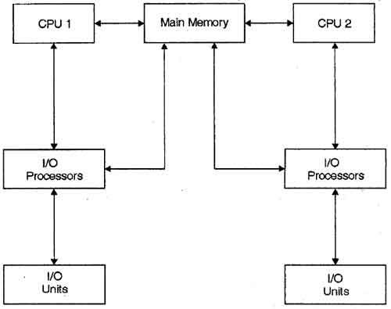
MULTIPROCESSING SYSTEMS

Slide 4
TYPES OF MULTIPROCESSOR
There are two types of multiprocessors
1.Shared memory multiprocessor
2.Distributed memory multiprocessor.
Symmetric Multiprocessors
In these types of systems, each processor contains a similar copy of the operating system and they all communicate with each other. All the processors are in a peer to peer relationship i.e. no master - slave relationship exists between them.
An example of the symmetric multiprocessing system is the Encore version of Unix for the Multimax Computer.

Slide 5
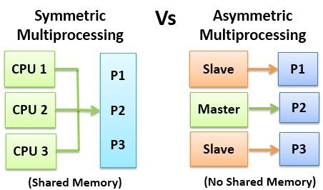
Asymmetric Multiprocessors
In asymmetric systems, each processor is given a predefined task. There is a master processor that gives instruction to all the other processors.
Asymmetric multiprocessor system contains a master slave relationship.
Asymmetric multiprocessor was the only type of multiprocessor available before symmetric multiprocessors were created.

Slide 6
EXAMPLE OF MULTIPROCESSING
A fine example of multiprocessing probably is the computer you have in your desktop right now — it is some time now that many processor chips have multiple cores — aka multicore —, meaning they are actually composed of several different processors.

Slide 7
Advantages of Multiprocessor Systems
More reliable Systems
Enhanced Throughput
More Economic Systems
Disadvantages of Multiprocessor Systems
Increased Expense
Complicated Operating System Required
Large Main Memory Required

Slide 8
REFERENCE
https://www.tutorialspoint.com/Multiprocessor-Systems
https://en.wikipedia.org/wiki/Multiprocessing
http://ecomputernotes.com/fundamental/disk-operating-system/multiprocessor-operating-system

Slide 9
THANK YOU

